Slide 1

BANK LOAN CASE STUDY

Slide 2
PROJECT DESCRIPTION
The given project asks us to apply Risk Analytics by analysing the data given for bank loan.
The project expects us to perform Exploratory Data Analysis to understand how consumer attribute which influence the tendency to default.
By EDA we will identify patterns of loan default and the driving factors which leads to these defaults. For this which has strong indicators of default are found.
We are expected to manage missing data, identify outliers, report any data imbalance, explain the result of univariate,segmented univariate, bivariate analysis and determine the top 10 correlation for the client with payment difficulties and all other cases.

Slide 3
APPROACH
IMPORTING PYTHON LIBRARIES
ASCERTAINING OUTLIERS
IDENTIFYING DATA IMBALANCE
UNIVARIATE, SEGMENTED UNIVARAITE AND BIVARIATE ANALYSIS
MANAGING THE NULL VALUES BY EITHER REMOVING OR IMPUTATION
FINDING CORRELATION

Slide 4


TECH STACH USED
JUPYTER Labs was used because they can help in easy python compilations and visualisation.
The file can be viewed in the link below:-
Click here to see the IPYNB file
Due to size constraint please don’t hesitate to view the visualisations in the IPYNB file.

Slide 5




INSIGHTS

Slide 6
TASK 1-DATA CLEANING AND MANIPULATION
FINDING AND HANDLING MISSING DATA
REMOVING UNWANTED COLUMNS
DROPPING COLUMNS WITH HIGH MISSING VALUE PERCENTAGE
DATA IMPUTATION IN IMPORTANT COLUMNS WHICH CAN NOT BE DROPPED AND DATA WITH LOW COUNT OF NULL VALUES
STANDARDISING VALUES

Slide 7
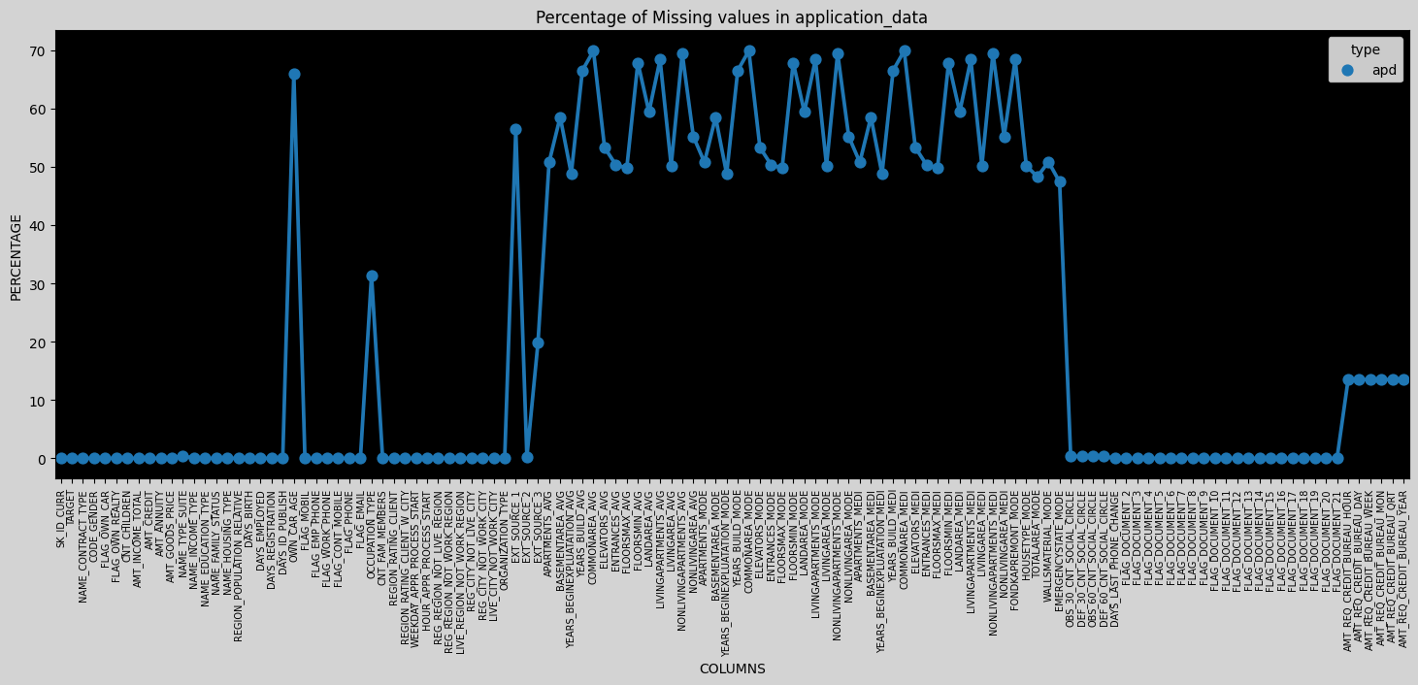
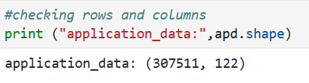
FINDING AND HANDLING MISSING DATA DATASET -1 ->APPLICATION DATA
Number of Rows =307511
Number of Columns=122
There are some data set related to days which is negative would have to manage that
The given line plot shows the columns and number of null values(extracted from the Jupyter File attached in Tech Stack used slide)
We will drop those columns with missing value % greater than 40%
As per Industrial Standard, max Threshold limit can be between 40% to 50 % depending upon the data acquired in specific sector

Slide 8
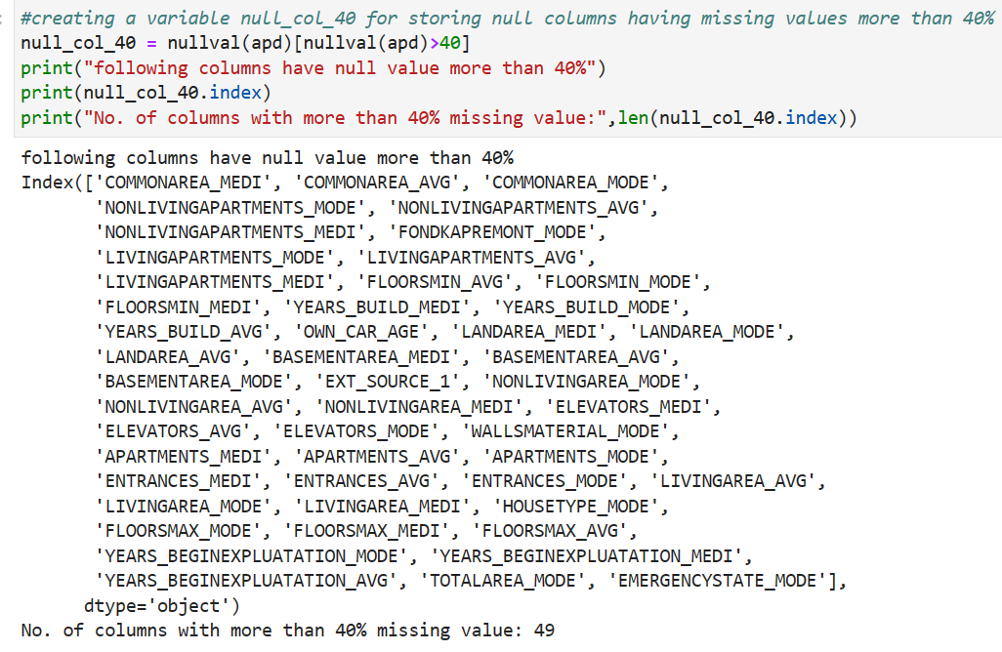
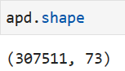
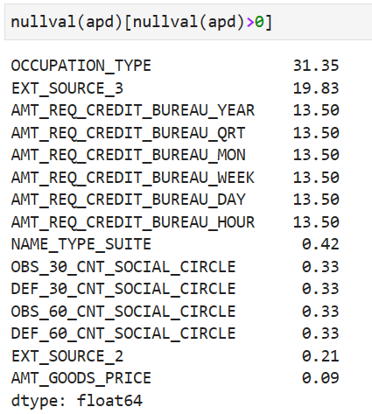
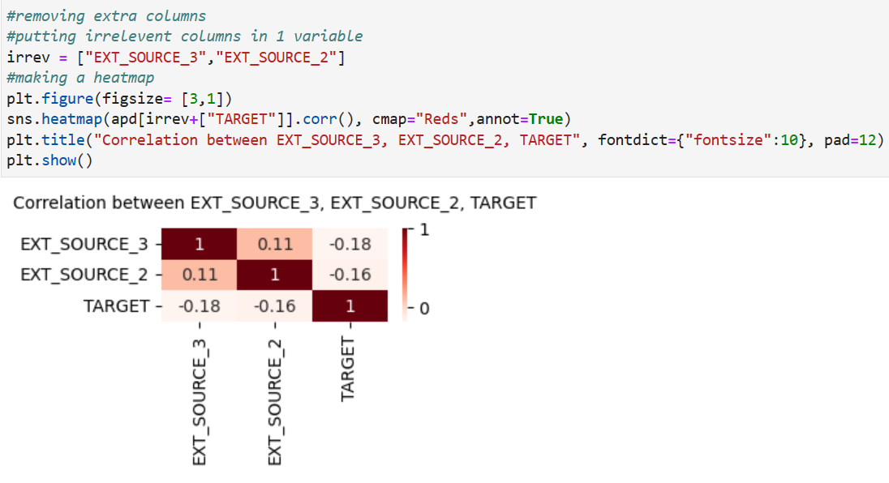
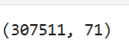
There are 49 col with null values greater than 40%
After dropping 49 col new shape is 307511 rows and
73 columns
Remaining columns with null value
As in the dictionary we see a normalised data set of ext source 1, because ext source 2 and ext source 3 have no linear correlation with target the the column ext source 2 and ext source 3 are dropped
After dropping we have 71 columns

Slide 9
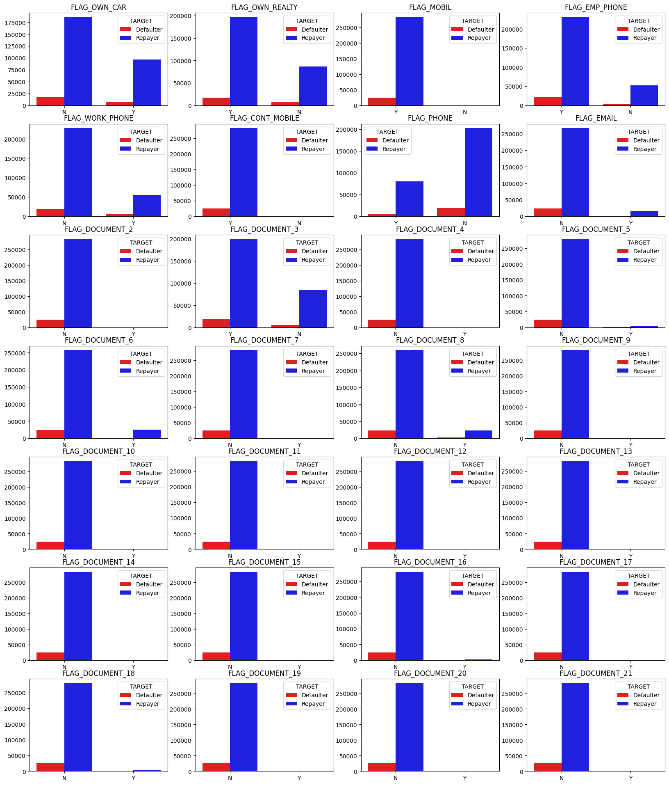
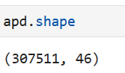
Checking column with FLAGS and determining their relationship with target column
Then checking correlation with target and removing unwanted columns
Columns (FLAG_OWN_REALTY, FLAG_MOBIL ,FLAG_EMP_PHONE, FLAG_CONT_MOBILE, FLAG_DOCUMENT_3) have more yeses than nos and from these keeping FLAG_DOCUMENT_3,FLAG_OWN_REALTY, FLAG_MOBIL more sense thus we can include these columns and remove all other FLAG columns for further analysis.
Hence we drop these columns and after removing all unnecessary columns now we have 46 relevant columns

Slide 10
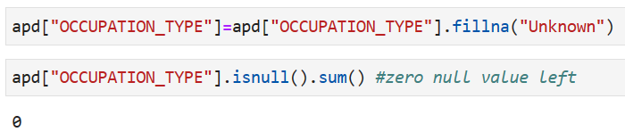
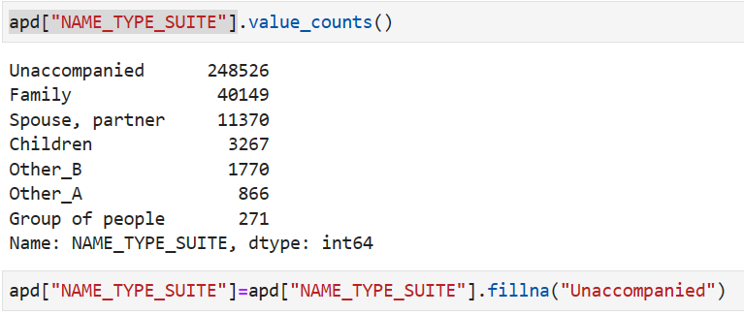
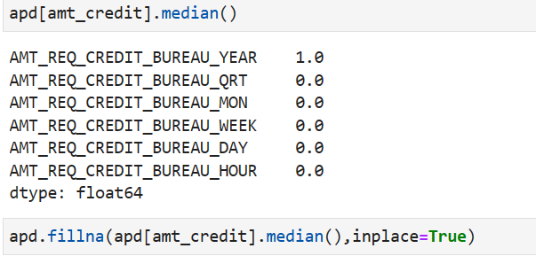
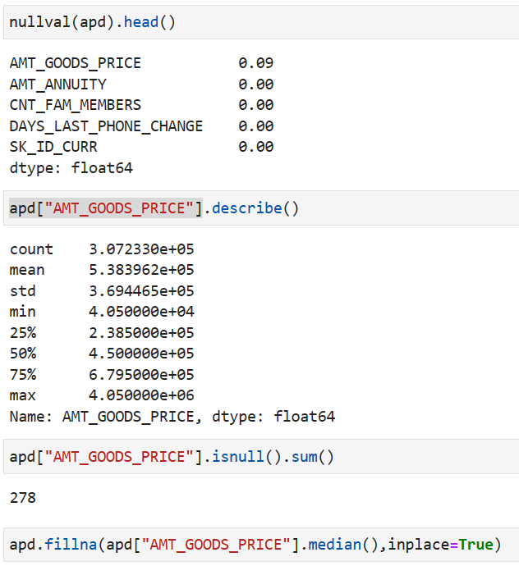
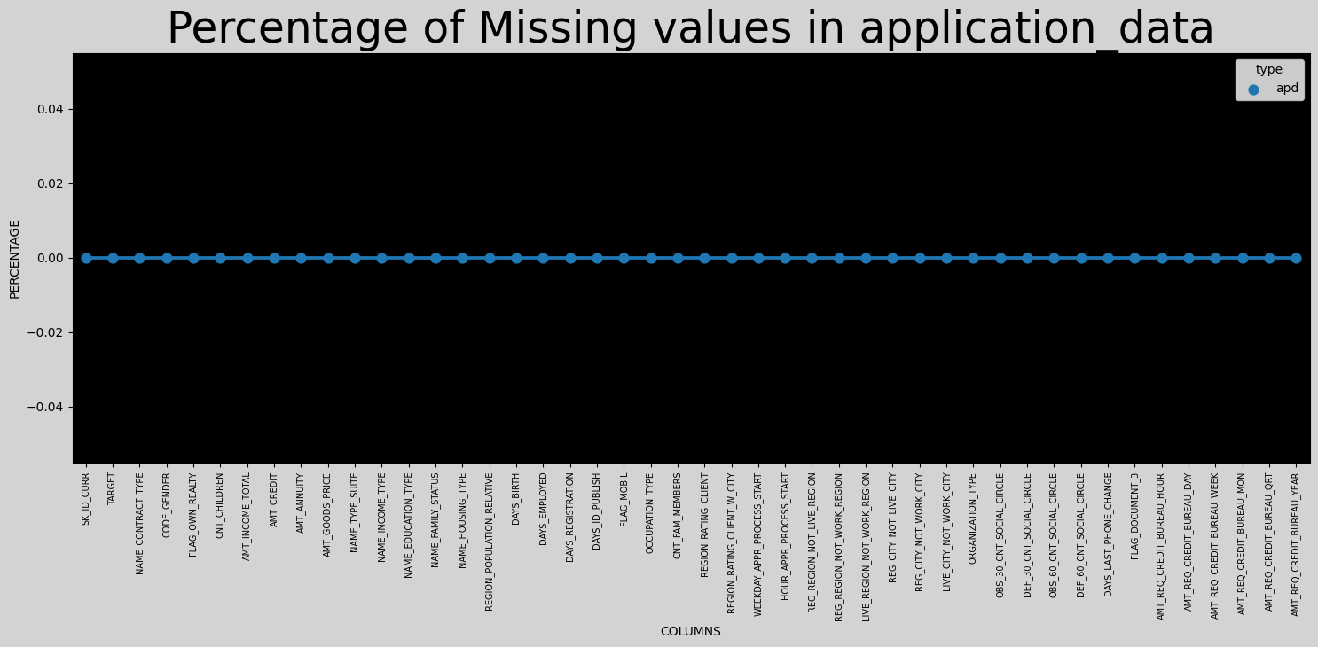
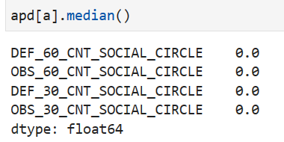
DATA IMPUTATION-DATASET1 APPLICATION DATA
In the column occupation type there are 31.35% null values hence we will change those to ‘Unknown’, this unknown column has the highest percentage.
Similarly in the column Name Type Suite, the missing values will be replaced with “Unaccompanied” which is the mode of the data.
For rest of the columns with null value we will replace them with their median values.
WE CAN SEE NO COLUMN WITH NULL VALUES

Slide 11
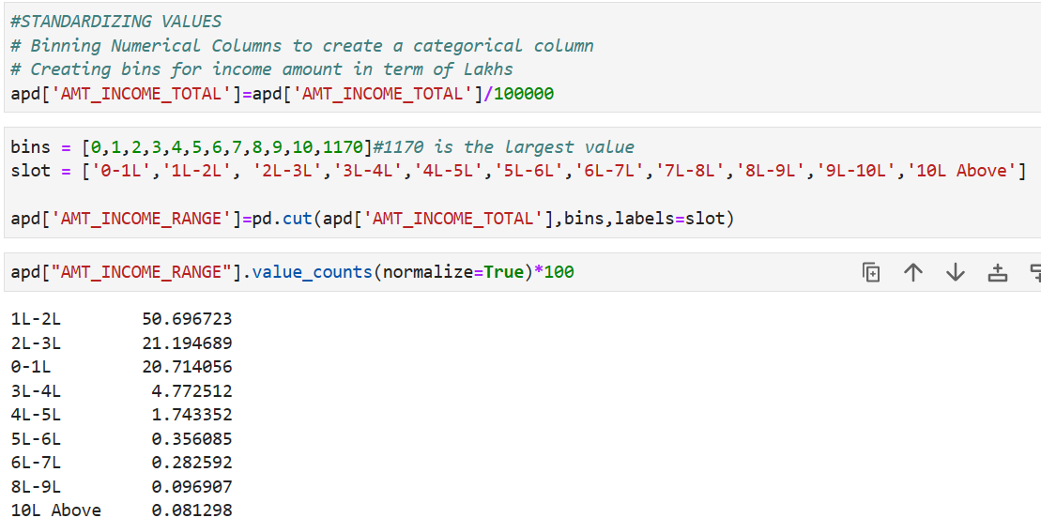
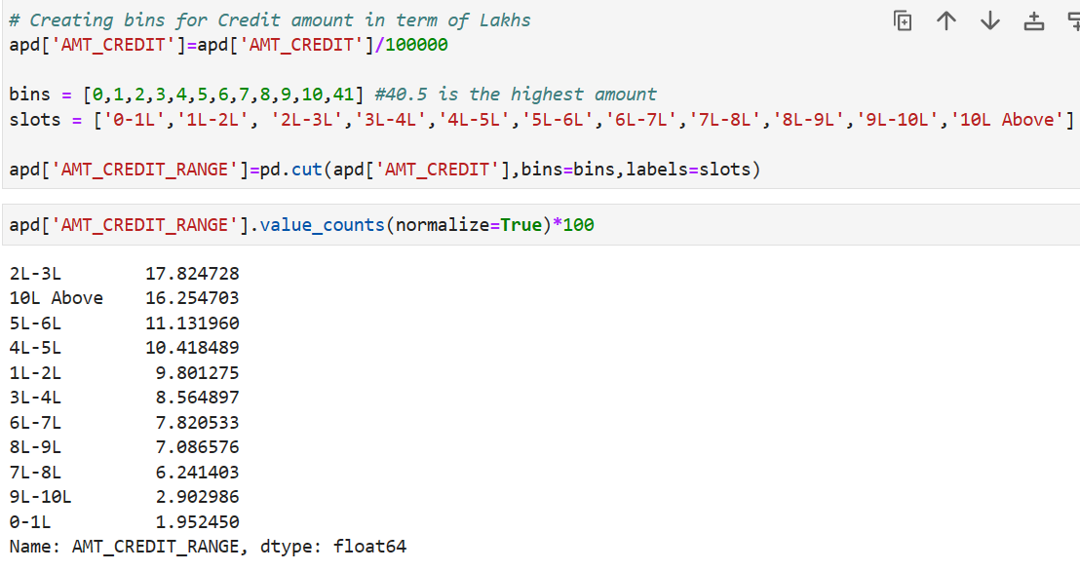
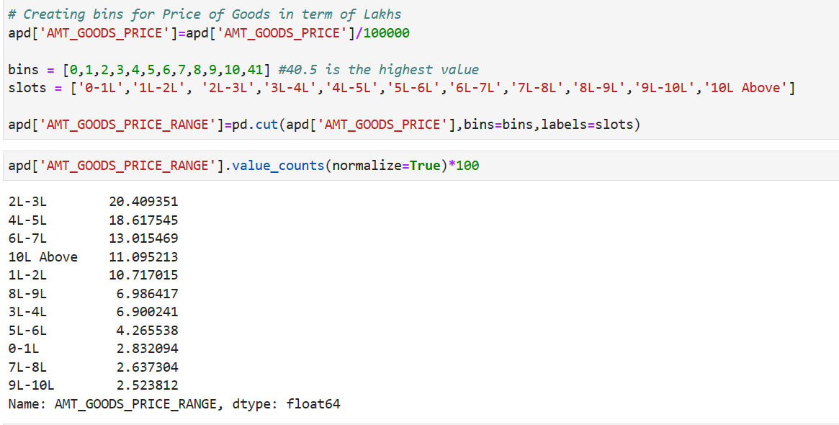
STANDARDIZING VALUES – DATASET-1 APPLICATION DATA
columns AMT_INCOME_TOTAL, AMT_CREDIT, AMT_GOODS_PRICE have very high values, thus will make these numerical columns in categorical columns for better understanding by BINNING

Slide 12
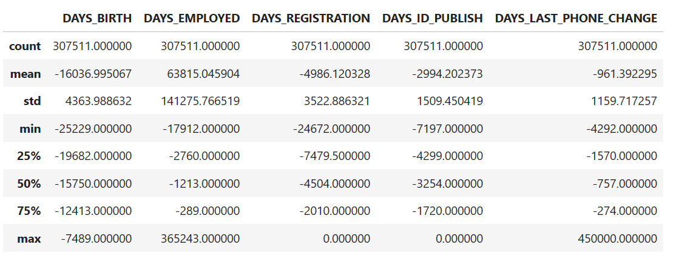
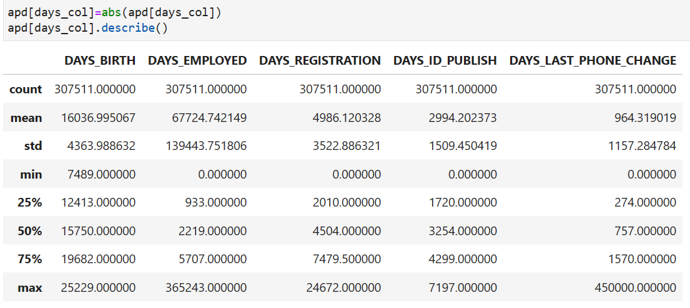

STANDARDIZING VALUES –DATASET-1 APPLICATION DATA
columns DAYS_BIRTH, DAYS_EMPLOYED, DAYS_REGISTRATION, DAYS_ID_PUBLISH, DAYS_LAST_PHONE_CHANGE which counts days have negative values. thus will correct those values

Slide 13
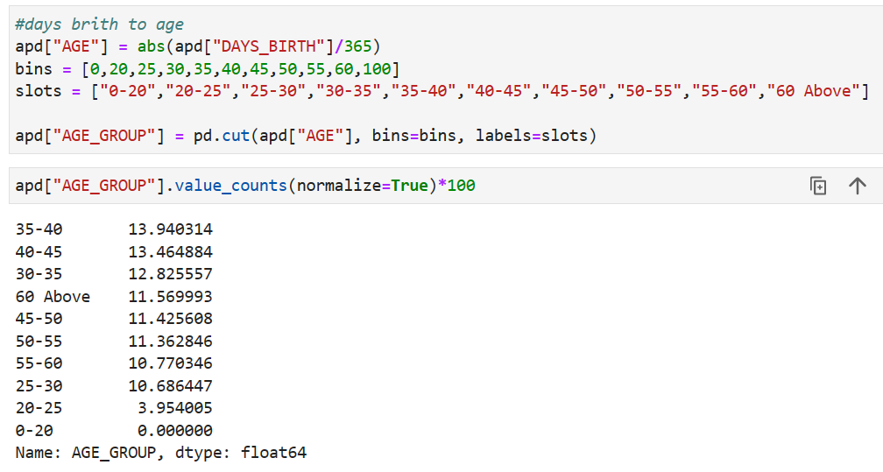
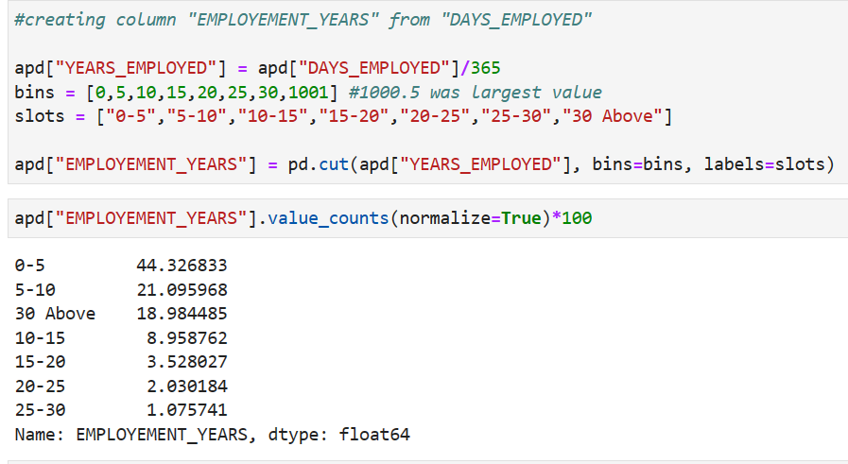
STANDARDIZING VALUES –DATASET-1 APPLICATION DATA
convert DAYS_BIRTH to AGE in years , DAYS_EMPLOYED to YEARS EMPLOYED

Slide 14
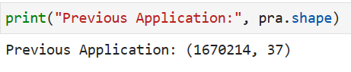
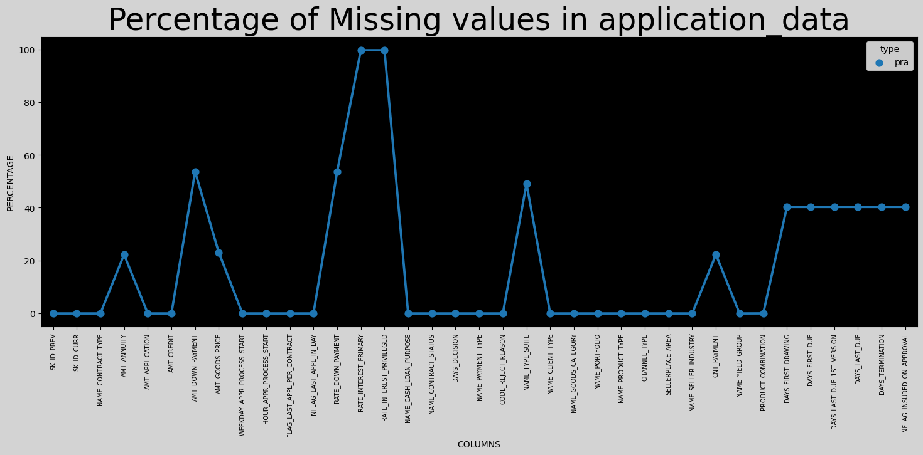
FINDING AND HANDLING MISSING DATA DATASET -2 ->PREVIOUS APPLICATION
Number of Rows =1670214
Number of Columns=37
There are some data set related to days which is negative would have to manage that
The given line plot shows the columns and number of null values(extracted from the Jupyter File attached in Tech Stack used slide)
We will drop those columns with missing value % greater than 50%
As per Industrial Standard, max Threshold limit can be between 40% to 50 % depending upon the data acquired in specific sector

Slide 15
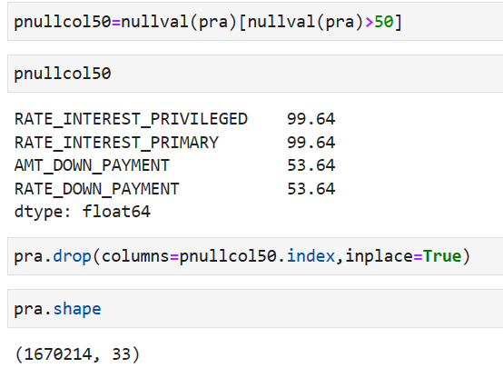
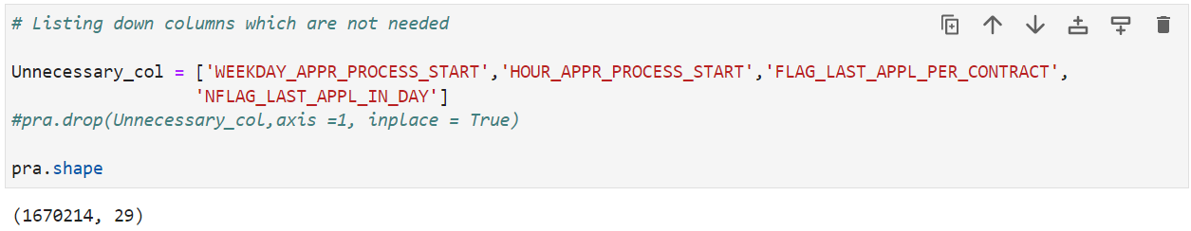
DROPPING UNWANTED COLUMNS
Removed 4 columns with null values greater than 50% , now there are 33 columns left
Dropped 4 more columns which were not necessary for the analysis, 29 columns
Left

Slide 16
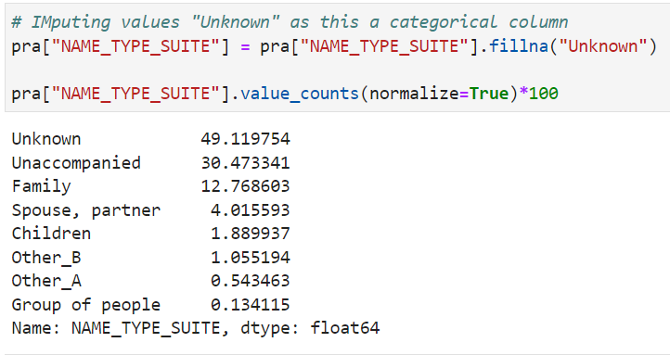
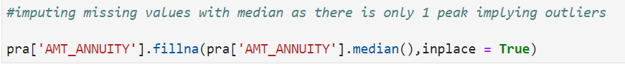
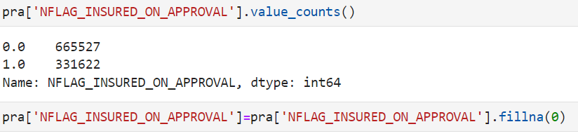
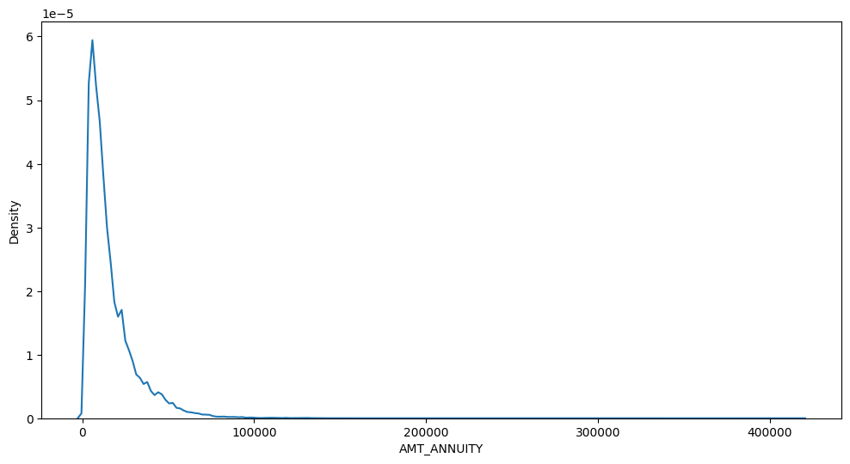
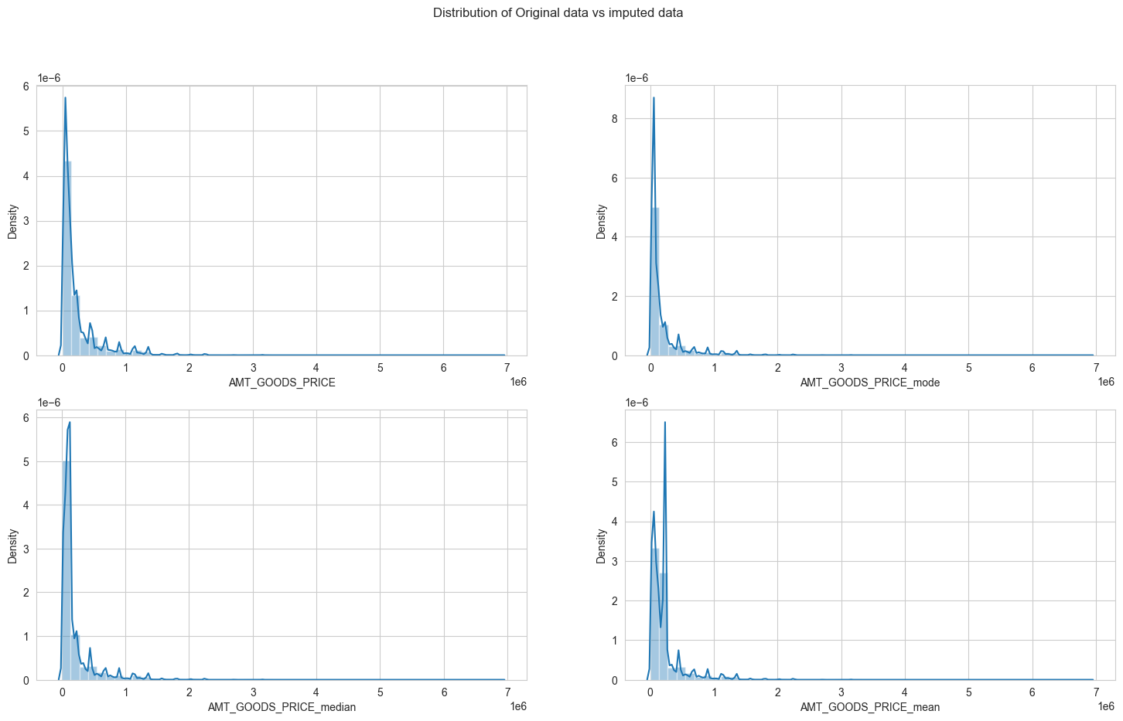
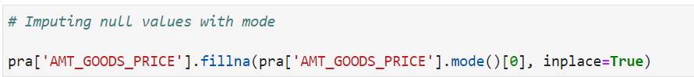
DATA IMPUTATION
In column Name_type_suit, unknown values filled
In column N_FLAG_INSURED_ON_APPROVAL null values were filled with mode i.e. 0
For AMT_ANNUITY as the kde plot is skewed with 1peak, null values were replaced by median
For AMT_GOOD_PRICE since kdeplot has Multiple peaks, the plot with replacing null values with mode median and mean was made to check which plot resembles the original one the most as it was the mode one null values were replaced with mode

Slide 17
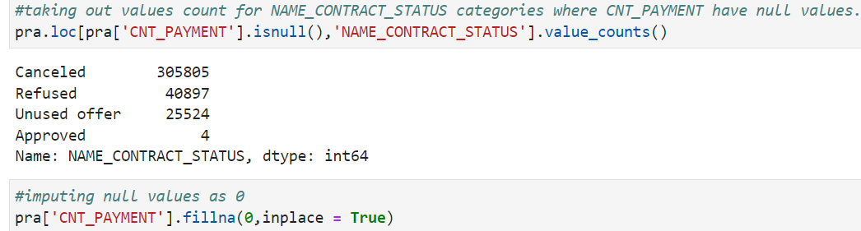
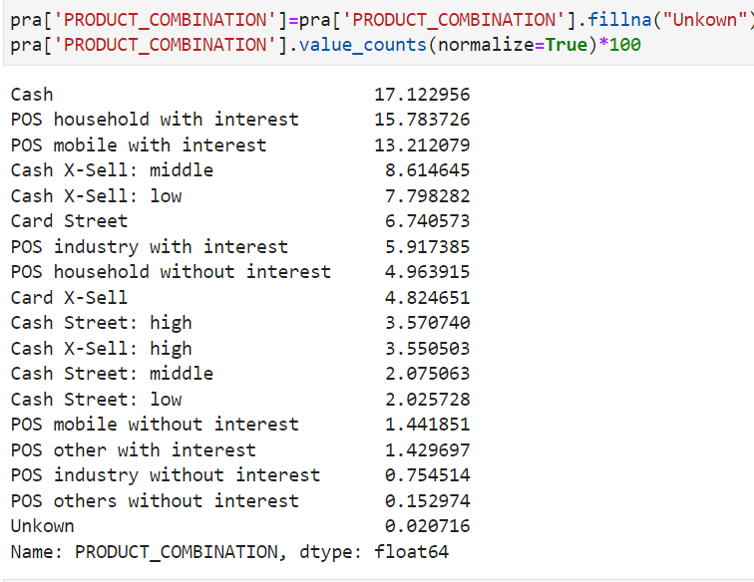
DATA IMPUTATION DATASET -2 ->PREVIOUS APPLICATION
Imputing CNT_PAYMENT with 0 as the NAME_CONTRACT_STATUS for these indicate that most of these loans were not started
In column PRODUCT_COMBINATION the null values were filled with “unknown”

Slide 18
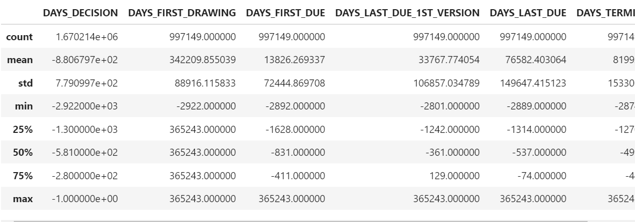
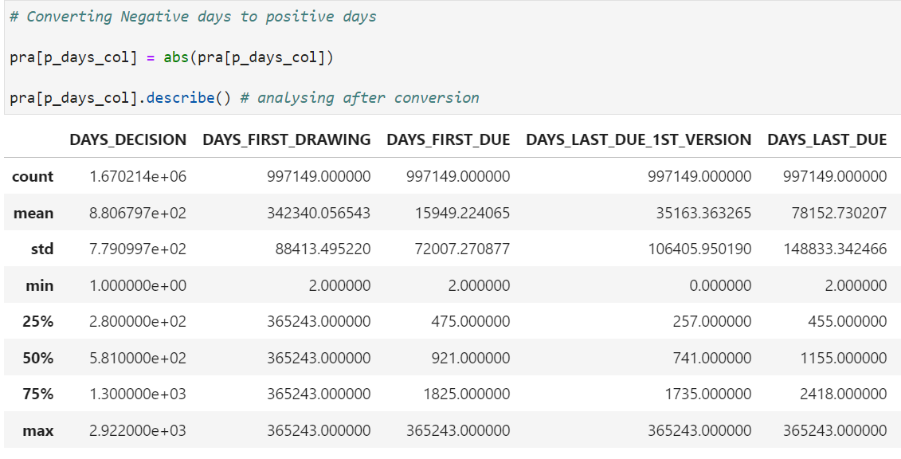
STANDARDIZING VALUES – DATASET-2 PREVIOUS APPLICATION
There are negative values in days column which needs to be rectified

Slide 19
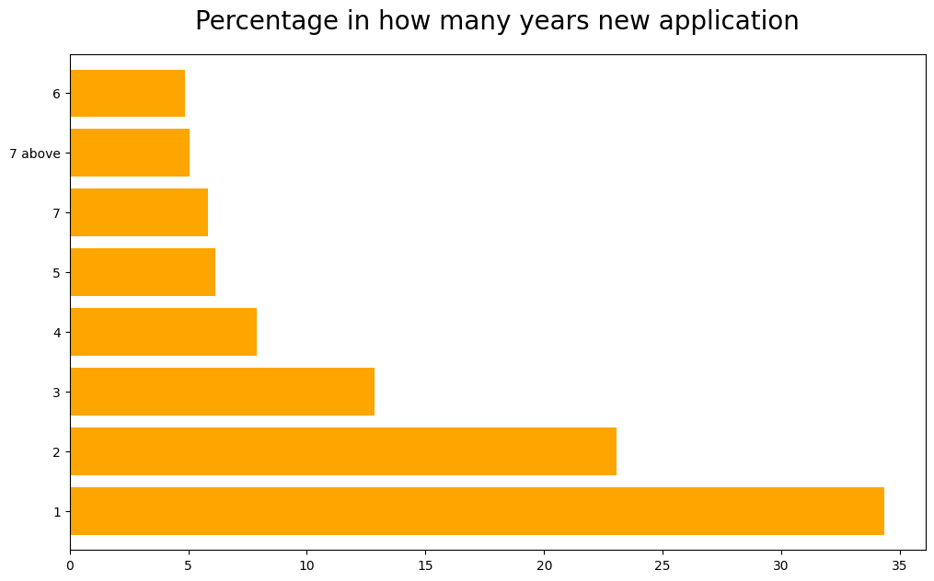
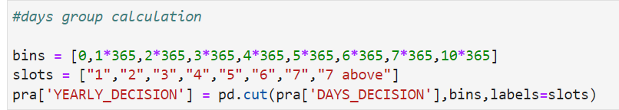

STANDARDIZING VALUES – DATASET-2 PREVIOUS APPLICATION
Standardizing values for days_decision column by converting them into years by binning, for better understanding of data after replacing the null values with mode.
About 35% applicant apply again after decision on previous loan
All Null Values have been removed

Slide 20
DATA CLEANING CONCLUSION
DATASET-1 APPLICATION DATA-> from 122 columns down to 53 columns
DATASET-2 PREVIOUS APPLICATION from 37 columns down to 34 columns

Slide 21
DATA CLEANING CONCLUSION
DATASET-2 PREVIOUS APPLICATION from 37 columns down to 34 columns

Slide 22

TASK-2-IDENTIFYING OUTLIER

Slide 23
OUTLIER IDENTIFICATION DATA SET-1 APPLICATION DATA
From describe we could find all the columns those who have high difference between max and 75 percentile and the ones which makes no sense having max value to be so high are captured below:
The box plot of these columns will reflect if they have outliers or not.

Slide 24
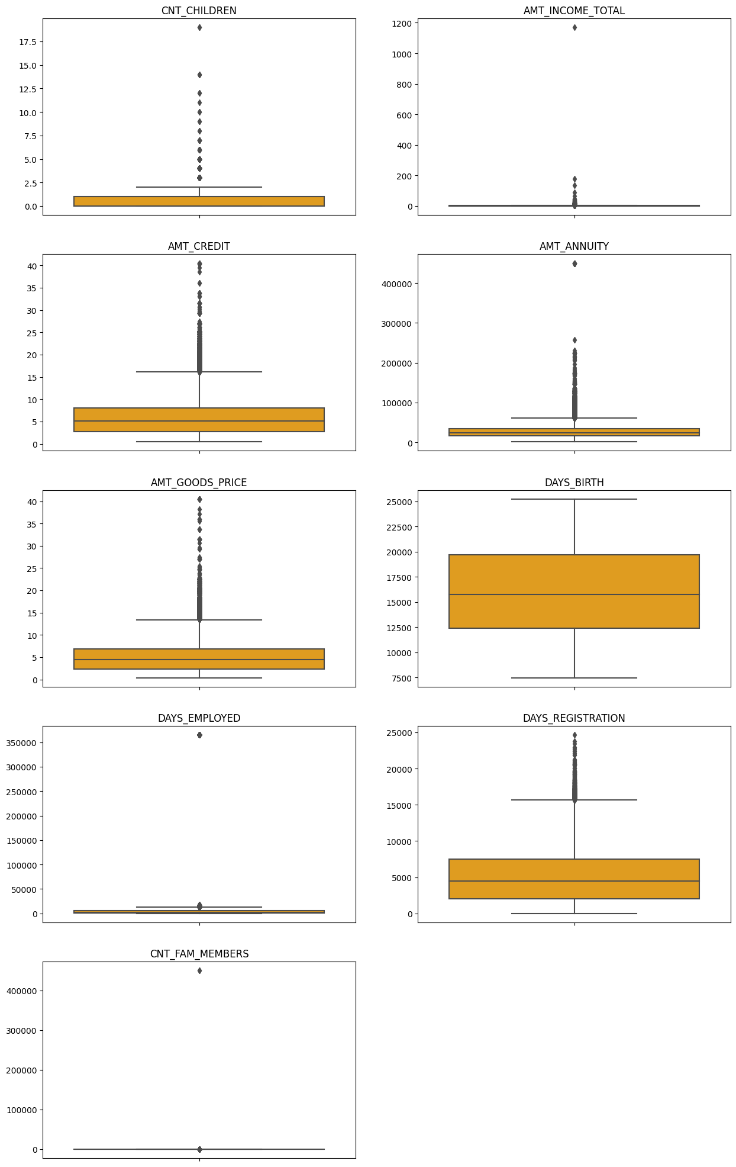
AMT_ANNUITY, AMT_CREDIT, AMT_GOODS_PRICE,CNT_CHILDREN have some number of outliers.
AMT_INCOME_TOTAL has huge number of outliers which indicate that few of the loan applicants have high income when compared to the others.
DAYS_BIRTH has no outliers which means the data available is reliable.
DAYS_EMPLOYED has outlier values around 350000(days) which is around 958 years which is impossible and hence this has to be incorrect entry.
CNT_FAM_MEMBERS has outlier value more than 45000 which is impossible hence it is an incorrect entry

Slide 25
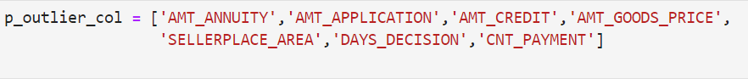
OUTLIER IDENTIFICATION DATA SET-2 PREVIOUS APPLICATION
From describe we could find all the columns those who have high difference between max and 75 percentile and the ones which makes no sense having max value to be so high are captured below:
The box plot of these columns will reflect if they have outliers or not.

Slide 26
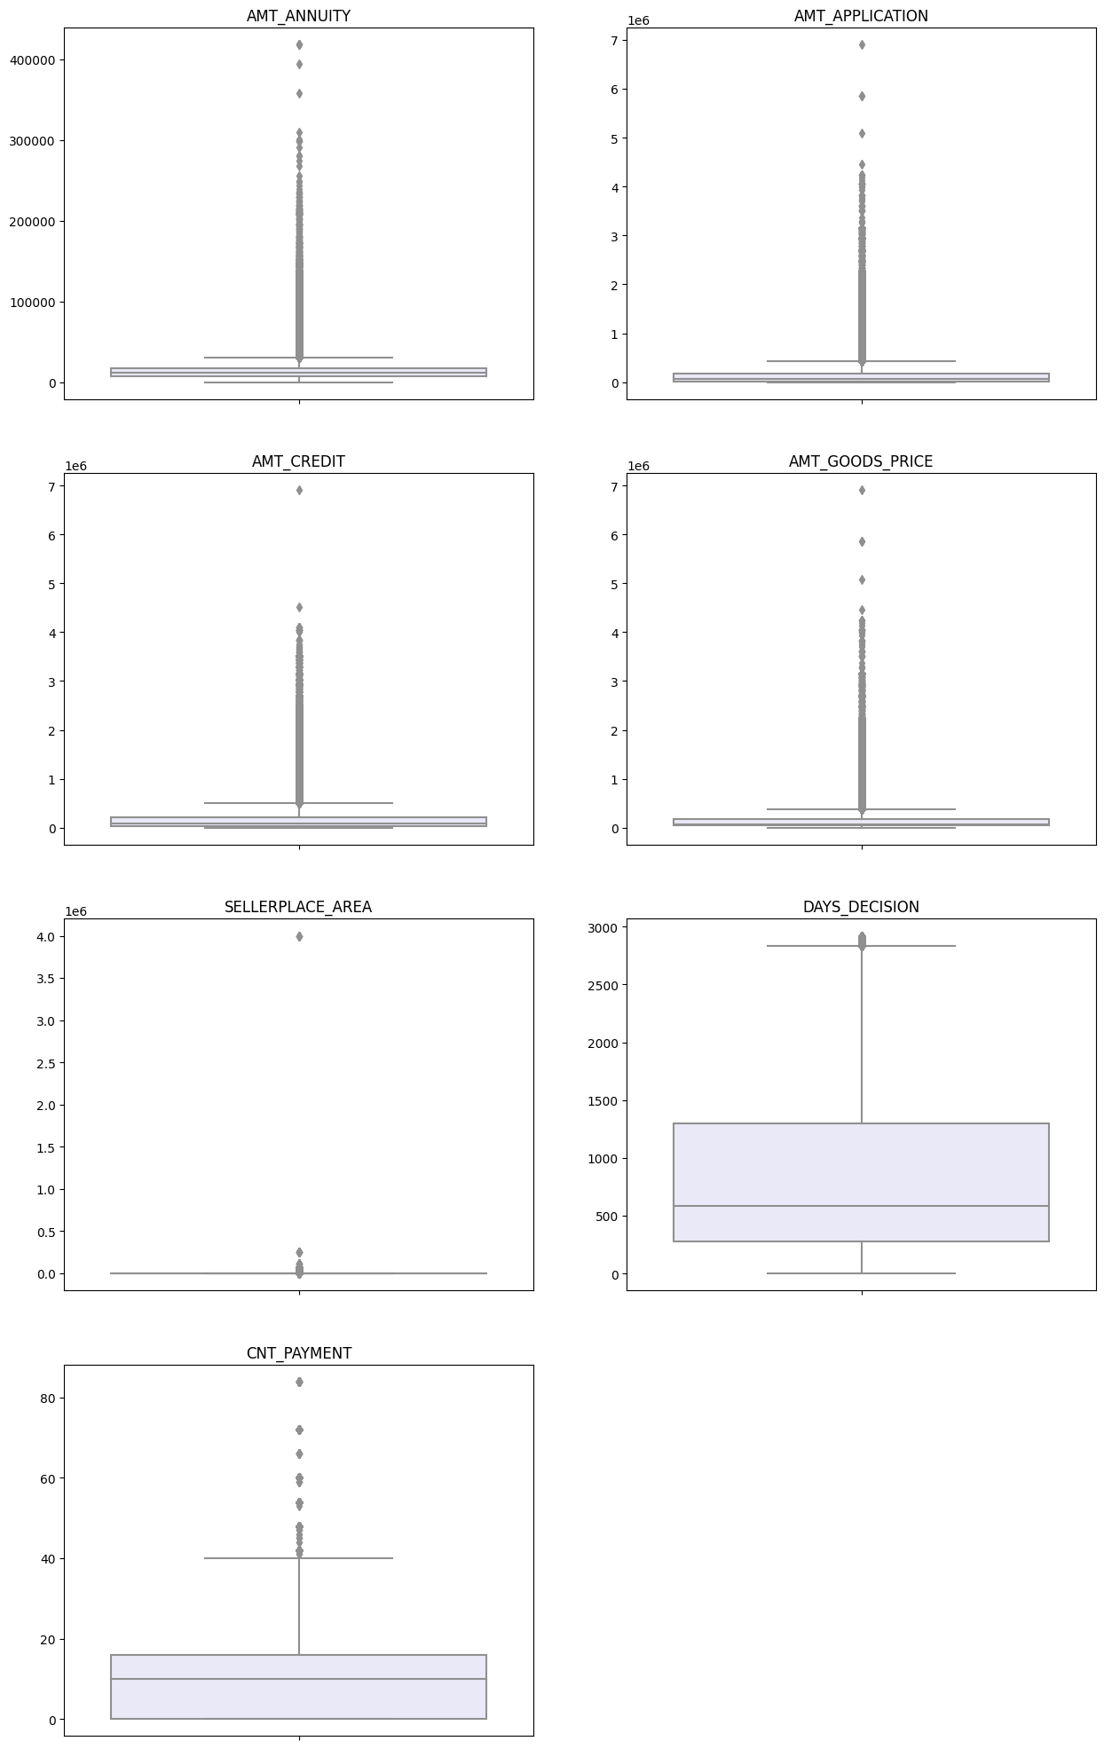
It can be seen that in previous application data
AMT_ANNUITY, AMT_APPLICATION, AMT_CREDIT, AMT_GOODS_PRICE, SELLERPLACE_AREA have huge number of outliers.
CNT_PAYMENT has few outlier values.
DAYS_DECISION has little number of outliers indicating that these previous applications decisions were taken recently.

Slide 27
TASK-3-REPORTING DATA IMBALANCE

Slide 28
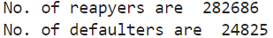
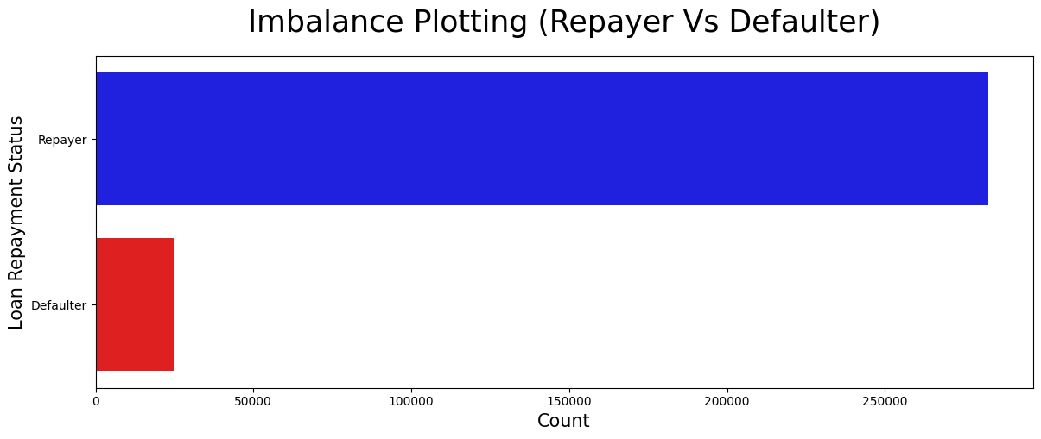
IMBALANCE BETWEEN DEFAULTER AND REPAYER COUNT

Slide 29

TASK-4 REPORTING RESULTS OF UNIVARIATE, SEGMENTED UNIVARIATE AND BIVARIATE ANALYSIS

Slide 30
METHODOLOGY ADOPTED
DATA ANALYSIS
CATEGORICAL DATA ANALYSIS
CATEGORICAL SEGMENTED UNIVARIATE ANALYSIS
CATEGORICAL BI/MULTIVARIATE ANALYSIS
NUMERIC DATA ANALYSIS
BI-FURCATION OF DATABASED BASED ON TARGET DATA
NUMERICAL SEGMENTED UNIVARIATE ANALYSIS
NUMERICAL BI/MULTIVARIATE ANALYSIS

Slide 31
APPRAOCH ADOPTED
To do the analysis, various functions are created to divide the data sets into categorical and numeric datasets
Later new more functions are created to analyse the dataset according to the required analysis (univariate/segmented univariate/ bivariate)
(THE FUNCTIONS CAN BE SEEN IN THE IPYNB ATTATCHED IN TECH STACK USED SLIDE)

Slide 32





CATEGORICAL VARIABLES ANALYSIS
SEGMENTED UNIVARIATE ANALYSIS

Slide 33
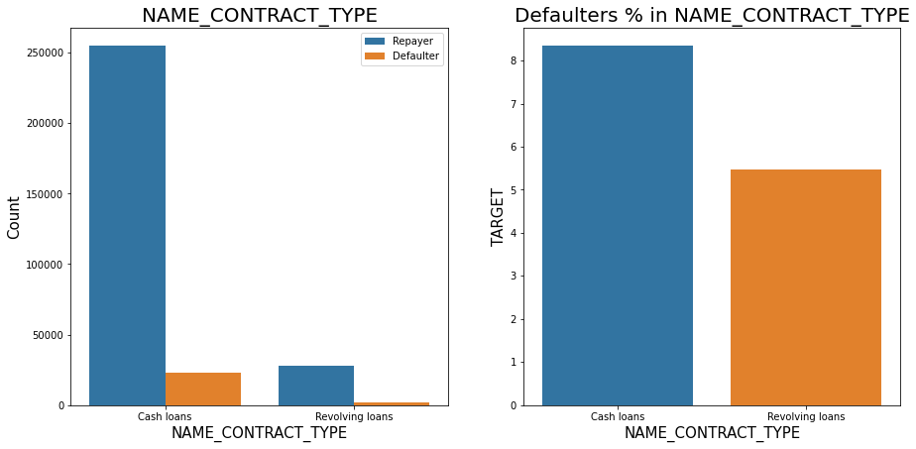
CONTRACT TYPE
Revolving loans are just a small fraction (10%) from the total number of loans.
Around 8-9% Cash loan applicants and 5-6% Revolving loan applicant are in defaulters.

Slide 34
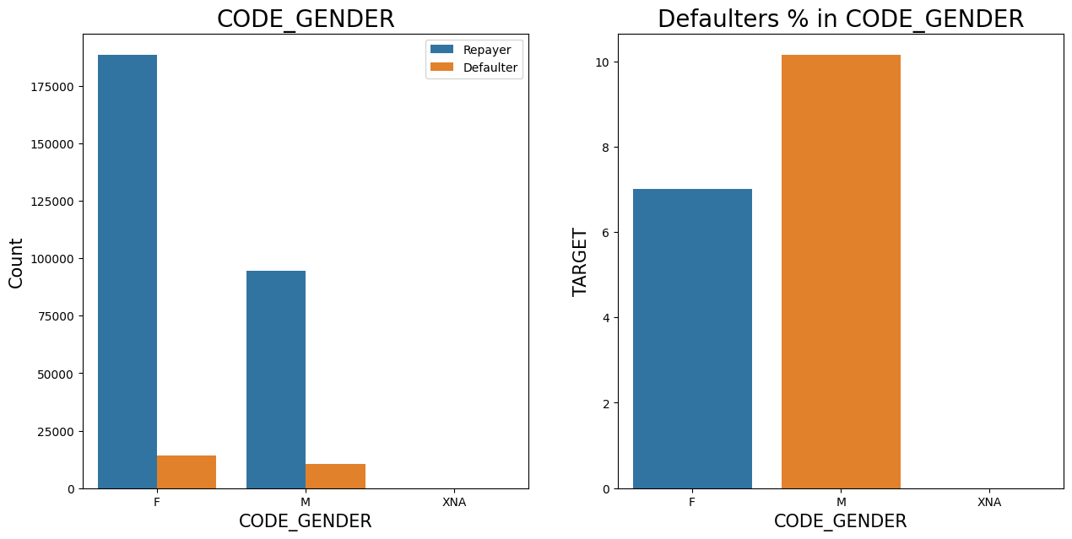
GENDER WISE LOAN REPAYMENT STATUS
The number of female clients is almost double the number of male clients.
Based on the percentage of defaulted credits, males have a higher chance of not returning their loans about 10%, comparing with women about 7%.

Slide 35
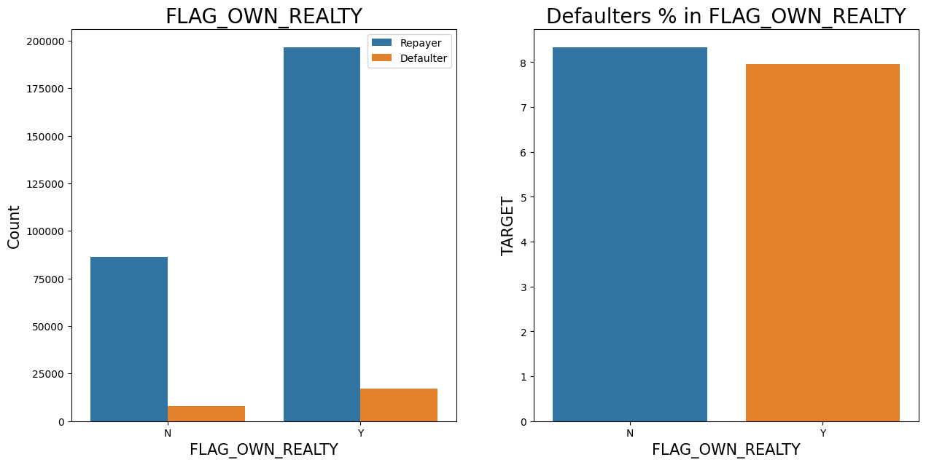
REAL ESTATE OWNERSHIP AND LOAN REPAYMENT STATUS
The clients who own real estate are more than double of the ones that don't own.
The defaulting rate of both categories are around the same (~8%). Thus we can infer that there is no correlation between owning a reality and defaulting the loan.

Slide 36
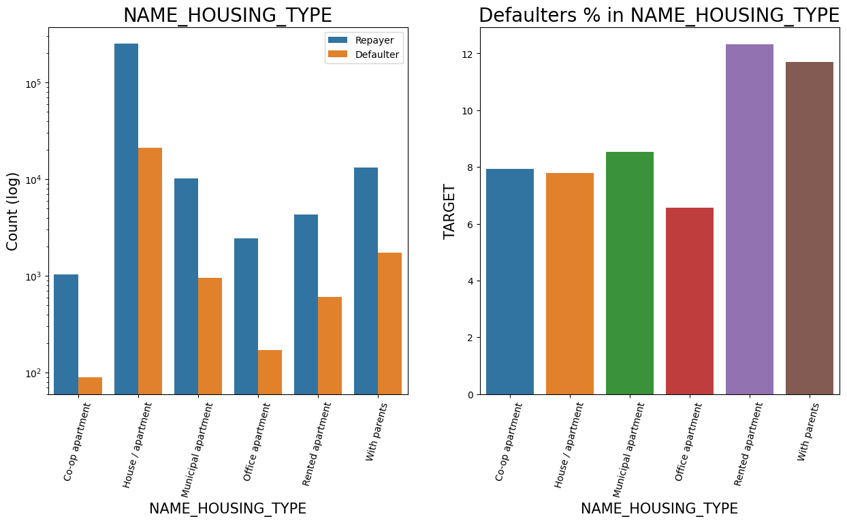
HOUSING TYPE AND LOAN REPAYMENT STATUS
Majority of people live in House/apartment.
People living in office apartments have lowest default rate.
People living with parents (~11.5%) and living in rented apartments(>12%) have higher probability of defaulting.

Slide 37
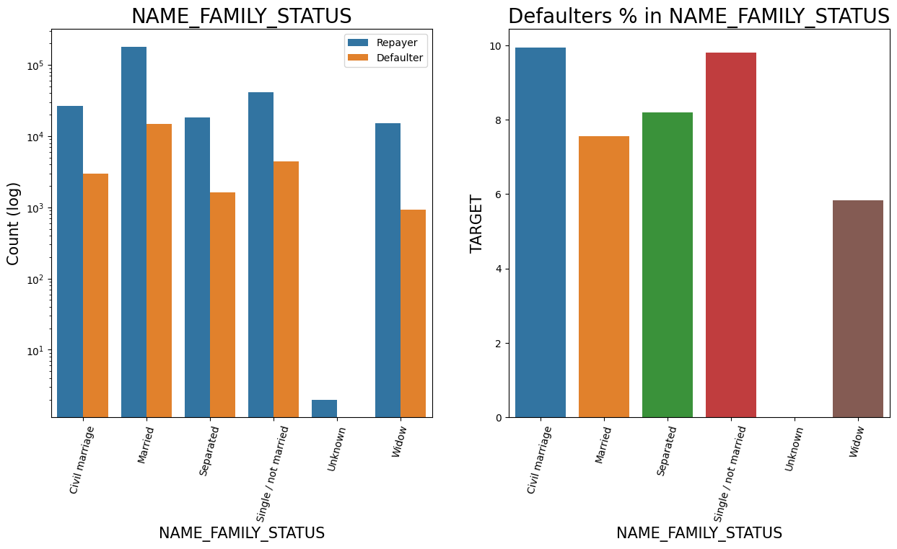
FAMILY STATUS AND LOAN REPAYMENT STATUS
Most of the people who have taken loan are married, followed by Single/not married and civil marriage.
In Percentage of defaulters, Civil marriage has the highest percent around (10%) and widow has the lowest around 6% (exception being Unknown).

Slide 38
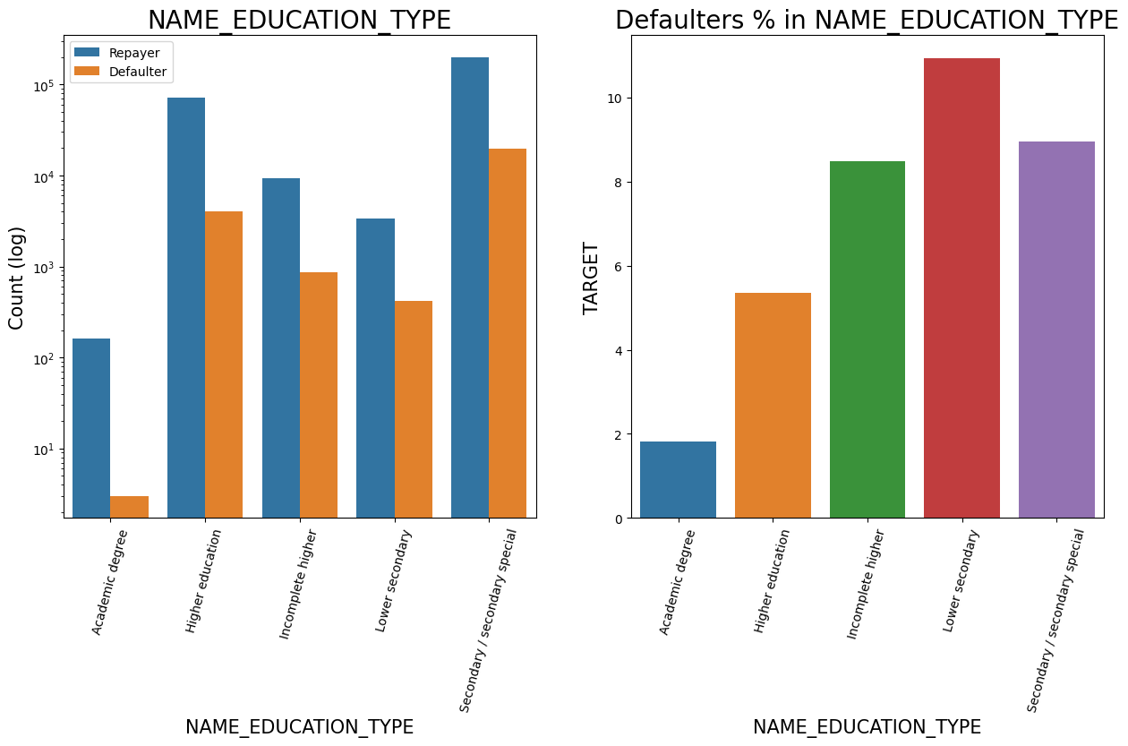
EDUCATION AND LOAN REPAYMENT STATUS
Majority of clients have Secondary/secondary special education, followed by clients with Higher education.
Very few clients have an academic degree
Lower secondary category have highest rate of defaulting around 11%.
People with Academic degree are least likely to default.

Slide 39
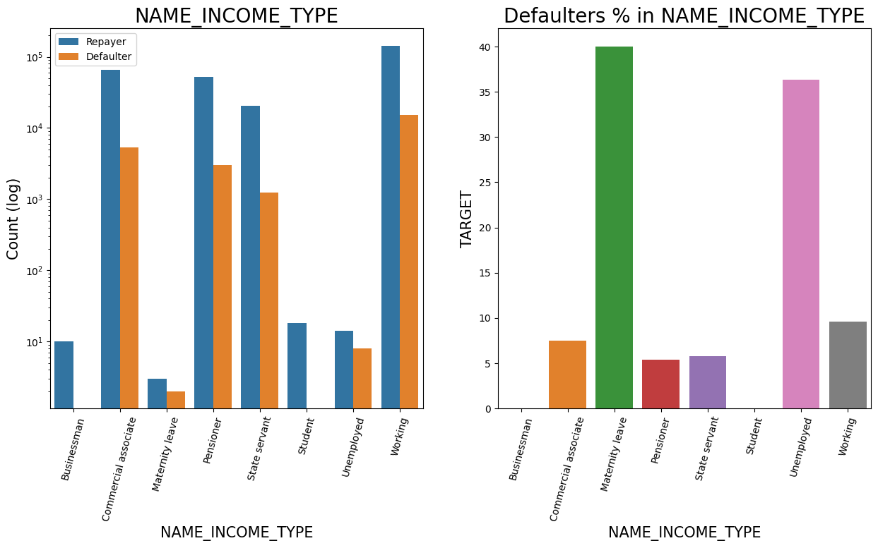
INCOME TYPE AND LOAN REPAYMENT STATUS
Most of applicants for loans income type is Working, followed by Commercial associate, Pensioner and State servant.
The applicants who are on Maternity leave have defaulting percentage of 40% which is the highest, followed by Unemployed (37%). The rest under average around 10% defaulters.
Student and Businessmen though less in numbers, do not have default record. Safest two categories for providing loan.

Slide 40

REGION RATING AND LOAN REPAYMENT STATUS
Most of the applicants are living in Region with Rating 2 place.
Region Rating 3 has the highest default rate (11%).
Applicant living in Region_Rating 1 has the lowest probability of defaulting, thus safer for approving loans.

Slide 41

OCCUPATION TYPE AND LOAN REPAYMENY STATUS
Most of the loans are taken by Laborers, followed by Sales staff.
IT staff are less likely to apply for Loan.
Category with highest percent of defaulters are Low-skill Laborers (above 17%), followed by Drivers and Waiters/barmen staff, Security staff, Laborers and Cooking staff.

Slide 42

ORGANIZATION TYPE AND LOAN REPAYMENT STATUS
Organizations with highest percent of defaulters are Transport: type 3 (16%), Industry: type 13 (13.5%), Industry: type 8 (12.5%) and Restaurant (less than 12%).
Self employed people have relative high defaulting rate, to be on safer side loan disbursement should be avoided or provide loan with higher interest rate to mitigate the risk of defaulting.
Most of the people application for loan are from Business Entity Type 3.
For a very high number of applications, Organization type information is unavailable(XNA).
It can be seen that following category of organization type has lesser defaulters thus safer for providing loans: Trade Type 4 and 5, Industry type 8.

Slide 43

EMPLOYMENT YEARS AND LOAN REPAYMENT STATUS
Majority of the applicants have working experience between 0-5 years. The defaulting rating of this group is also the highest which is around 10%.
With increase of employment year, defaulting rate is gradually decreasing.
Those with experience of 25-30 years have lowest default percentage.

Slide 44

AMOUNT CREDIT AND LOAN REPAYMENT STATUS
there are high number of applicants have loan in range of 2-3 Lakhs followed by 10 Lakh above range.
People who get loan for 3-6 Lakhs have most number of defaulters than other loan range.

Slide 45

INCOME RANGE AND LOAN REPAYMENT STATUS
Majority of the applications have Income total less than 3 Lakhs.
Application with Income less than 3 Lakhs has high probability of defaulting.
Applicant with Income 7-8 Lakhs are less likely to default.

Slide 46

CHILDREN COUNT AND LOAN REPAYMENT STATUS
Most of the applicants do not have children.
Very few clients have more than 3 children.
Client who have more than 4 children has a very high default rate with child count 9 and 11 showing 100% default rate.

Slide 47

COUNT FAMILY MEMBERS AND LOAN REPAYMENT STATUS
Family member follows the same trend as children where having more family members increases the risk of defaulting.
A Family with 11 & 13 members have 100% default rate.

Slide 48

CATEGORICAL VARIABLES ANALYSIS
BIVARIATE/MULTIVARAITE ANALYSIS

Slide 49

INCOME TYPE AND TOTAL INCOME RELATIONSHIP
It can be seen that Businessman’s income is the highest and the estimated range with a default 95% confidence level seem to indicate that the income of a Businessman could be in the range of slightly close to 4 lakhs and slightly above 10 lakhs.

Slide 50
NUMERICAL VARIABLES ANALYSIS
UNIVARIATE ANALYSIS

Slide 51

AMOUNT AND LOAN REPAYMENT STATUS
Most no of loans are given for goods price below 10 lakhs.
Most people pay annuity below 50K for the credit loan.
Credit amount of the loan is mostly less then 10 lakhs.
The repayers and defaulters distribution overlap in all the plots and hence we cannot use any of these variables in isolation to make a decision.

Slide 52
NUMERICAL VARIABLES ANALYSIS
BIVARIATE ANALYSIS

Slide 53

GOOD PRICE AMOUNT AND CREDIT AMOUNT BIVARIATE ANALYSIS
When the credit amount goes beyond 30 Lakhs, there is an increase in defaulters.

Slide 54

LOAN REPAYMENT STATUS BY PLOTTING AGAINST AMOUNT VARIABLES
When Annuity Amount > 15K and Good Price Amount > 20 Lakhs, there is a lesser chance of defaulters.
Loan Amount(AMT_CREDIT) and Goods price(AMT_GOODS_PRICE) are highly correlated as based on the scatterplot where most of the data are consolidated in form of a line.
There are very less defaulters for AMT_CREDIT >20 Lakhs.

Slide 55
DATA SET-3 VARAIABLE ANALYSIS->MERGEED DATA SETS APPLICATION DATA ANDPREVIOUS APPLICATION
UNIVARAITE AND BIVARIATE ANALYSIS

Slide 56

CONTRACT STATUS AND REPAYMENT OF LOANS
repaid LOANS

Slide 57

CONTRACT STATUS AND REPAYMENT OF LOANS
DEFAULTED LOANS

Slide 58

CONTRACT STATUS AND REPAYMENT OF LOANS
FROM THE PERIOUS GRAPHS THE FOLLOWING CAN BE INFERRED
Loan purpose has high number of unknown values (XAP, XNA).
Loan taken for the purpose of Repairs looks to have highest default rate.
Huge number application have been rejected by bank or refused by client which are applied for Repair or Other. from this we can infer that repair is considered high risk by bank. Also, either they are rejected or bank offers loan on high interest rate which is not feasible by the clients and they refuse the loan.

Slide 59


NAME CONTRACT STATUS AND LOAN REPAYMENT STATUS
90% of the previously cancelled client have actually repaid the loan. Revising the interest rates would increase business opportunity for these clients.
88% of the clients who have been previously refused a loan has paid back the loan in current case.
Refusal reason should be recorded for further analysis as these clients could turn into potential repaying customer.

Slide 60

NAME CONTRACT STATUS AND AMOUNT INCOME BIVARIATE ANALYSIS
The point plot show that the people who have not used offer earlier have defaulted even when there average income is higher than others.

Slide 61

CONTRACT STATUS & SOCIAL CIRCLE BIVARAITE ANALYSIS
Clients who have average of 0.13 or higher their DEF_60_CNT_SOCIAL_CIRCLE score tend to default more and thus analysing client's social circle could help in disbursement of the loan.

Slide 62
TASK-5 CORRELATEION BETWEEN VARIABLES AND REPAYMENT/DEFAULT

Slide 63


CORRELATION BETWEEN VARIABLES WHEN LOAN REPAID
1. Credit amount is highly correlated with:
Goods Price Amount
Loan Annuity
Total Income
2. We can also see that repayers have high correlation in number of days employed.

Slide 64


CORRELATION BETWEEN VARIABLES WHEN DEFAULT
Credit amount is highly correlated with good price amount which is same as repaid.
Credit amount is highly correlated with:
Goods Price Amount
Loan Annuity
Total Income

Slide 65
TASK-6 FINAL SUMMARY CONCLUSION

Slide 66
FINAL SUMMARY AND CONCLUSION
After analysing the datasets, there are few attributes of a client with which the bank would be able to identify if they will repay the loan or not.

Slide 67

DECISIVE FACTOR WHETHER AN APPLICANT WILL BE REPAYER
NAME_EDUCATION_TYPE: Academic degree has less defaults.
NAME_INCOME_TYPE: Student and Businessmen have no defaults.
REGION_RATING_CLIENT: RATING 1 is safer.
ORGANIZATION_TYPE: Clients with Trade Type 4 and 5 and Industry type 8 have defaulted less than 3%.
DAYS_BIRTH: People above age of 50 have low probability of defaulting.
DAYS_EMPLOYED: Clients with 40+ year experience having less than 1% default rate.
AMT_INCOME_TOTAL:Applicant with Income more than 700,000 are less likely to default.
NAME_CASH_LOAN_PURPOSE: Loans bought for Hobby, Buying garage are being repaid mostly.
CNT_CHILDREN: People with zero to two children tend to repay the loans.

Slide 68

DECISIVE FACTOR WHETHER AN APPLICANT WILL BE DEFAULTER
CODE_GENDER: Men are at relatively higher default rate.
NAME_FAMILY_STATUS : People who have civil marriage or who are single default a lot.
NAME_EDUCATION_TYPE: People with Lower Secondary & Secondary education.
NAME_INCOME_TYPE: Clients who are either at Maternity leave OR Unemployed default a lot.
REGION_RATING_CLIENT: People who live in Rating 3 has highest defaults.
OCCUPATION_TYPE: Avoid Low-skill Laborers, Drivers and Waiters/barmen staff, Security staff, Laborers and Cooking staff as their default rate is huge.
ORGANIZATION_TYPE: Organizations with highest percent of loans not repaid are Transport: type 3 (16%), Industry: type 13 (13.5%), Industry: type 8 (12.5%) and Restaurant (less than 12%). Self-employed people have relative high defaulting rate, and thus should be avoided to be approved for loan or provide loan with higher interest rate to mitigate the risk of defaulting.
DAYS_BIRTH: Avoid young people who are in age group of 20-40 as they have higher probability of defaulting.
DAYS_EMPLOYED: People who have less than 5 years of employment have high default rate.
CNT_CHILDREN & CNT_FAM_MEMBERS: Client who have children equal to or more than 9 default 100% and hence their applications are to be rejected.
AMT_GOODS_PRICE: When the credit amount goes beyond 3lakhs, there is an increase in defaulters.

Slide 69

FACTORS THAT LOAN CAN BE GIVEN ON CONDITION OF HIGH INTEREST RATE TO MITIGATE ANY DEFAULT RISK LEADING TO BUSINESS LOSS:
NAME_HOUSING_TYPE: High number of loan applications are from the category of people who live in Rented apartments & living with parents and hence offering the loan would mitigate the loss if any of those default.
AMT_CREDIT: People who get loan for 3-6 Lakhs tend to default more than others and hence having higher interest specifically for this credit range would be ideal.
AMT_INCOME: Since 90% of the applications have Income total less than 3Lakhs and they have high probability of defaulting, they could be offered loan with higher interest compared to other income category.
CNT_CHILDREN & CNT_FAM_MEMBERS: Clients who have 4 to 8 children has a very high default rate and hence higher interest should be imposed on their loans.
NAME_CASH_LOAN_PURPOSE: Loan taken for the purpose of Repairs seems to have highest default rate. A very high number applications have been rejected by bank or refused by client in previous applications as well which has purpose as repair or other. This shows that purpose repair is taken as high risk by bank and either they are rejected, or bank offers very high loan interest rate which is not feasible by the clients, thus they refuse the loan. The same approach could be followed in future as well.

Slide 70
SUGGESTIONS
90% of the previously cancelled client have actually repaid the loan. Record the reason for cancellation which might help the bank to determine and negotiate terms with these repaying customers in future for increase business opportunity.
88% of the clients who were refused by bank for loan earlier have now turned into a repaying client. Hence documenting the reason for rejection could mitigate the business loss and these clients could be contacted for further loans.

Slide 71


RESULT
The project helped in strengthening ability to use python for data analysis.
Due to the detailed nature of the project multiple rows and columns, the project helped strengthen the usage of pandas, NumPy, matplotlib and seaborn libraires.
The project helped in perfecting my data cleaning and data visualisation methodologies.
I have also worked on making a more effective presentation.

